Slide 1
How to define ‘ending homelessness’?
Matt Downie, Director of Policy and External Affairs, Crisis
20th April 2017

Slide 2

Why a definition matters
Shared ambition
Data
Efficiency
Challenge
Political ownership

Slide 3
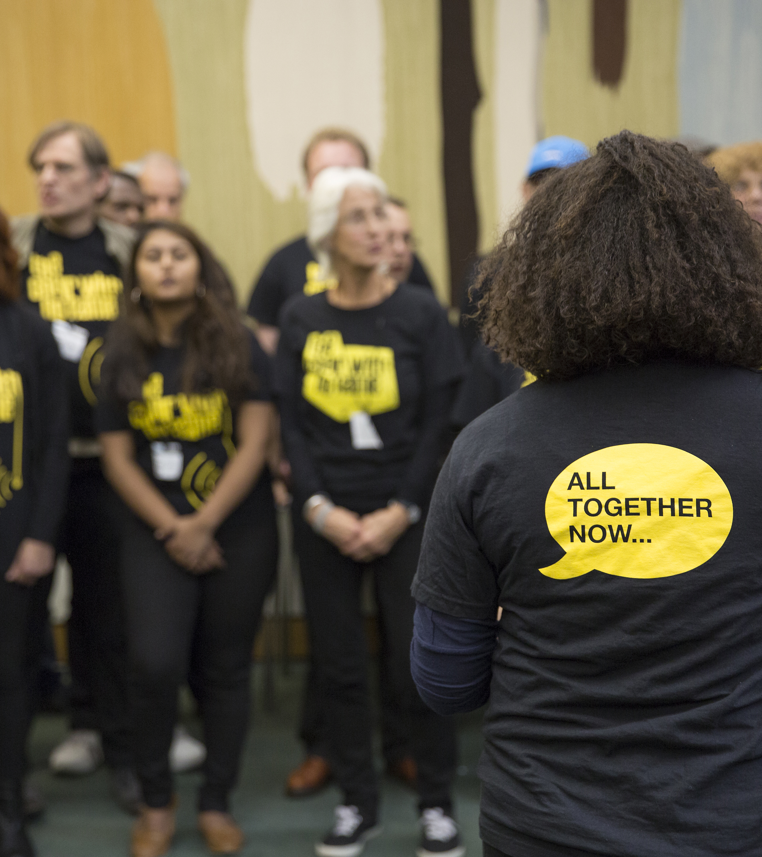
What to consider in a proposed definition
The reality for homelessness people
Existing systems and context
Political audience
Framing

Slide 4
Functional Zero vs. Absolute Zero
Functional Zero
Absolute Zero

Slide 5
Our proposed definition
No one sleeping rough
No one living in shelters, hostels or other emergency accommodation without a plan to move into suitable housing within an appropriate timescale
No one living in dangerous or insecure accommodation or situations
No one homeless as a result of leaving the care system, prison, or other state institution
Everyone at immediate risk of homelessness gets the help that prevents it happening

Slide 6
What do you think?

Slide 7
Contact us:
Matt Downie, Director of Policy and External Affairs
Email: matthew.downie@crisis.org.uk

