Slide 1
Housing Needs Reorganisation
Example options and proposals
Crisis Consultancy Service

Slide 2
Purpose of this document
Outline conceptual models for a future Housing Needs structure, developed by Crisis Consultancy Service working with a local authority. Provided options for discussion, appraisal against agreed principles, testing with officers and initial decision making & prioritisation. Purpose at this stage was not to get to the level of grading, role profiles, budgets etc.
Options include:
Visual functional model with key accountabilities/ capabilities
Example high-level customer journey
Supporting narrative with some key risks/ assumptions

Slide 3
Practice review
Through our extensive work with local authorities across GB, Crisis have access to a wide range of practice evidence and experience from other local authorities. We have outlined here points from a practice review relating specifically to the service models and structures used by other local authorities. There is no "best practice model" or ideal way of setting up a statutory homelessness service functionally. Some LAs use triage models, generic officers, "split" models etc. to varying degrees of success. The structure is a facilitator of best practice but only one factor (alongside technology, staff, performance management etc.). The intention here is to provide some inspiration and common themes of good practice in this area:
Early intervention/ outreach teams. Universal housing options advice and targeted early intervention (pre-56 days). To identify at risk households (case finding) early and deliver integrated casework. Usually includes partner engagement/ upskilling/ coordinating to build community resilience, floating advice (embedding housing specialists in local community), data specialists to facilitate targeting, community navigators, universal support officers etc. Can be integrated across the council with Early Help services (housing navigators) and locality-based (e.g. North/ Central/ South) facilitating multi-disciplinary responses
Above can include tenancy relations officers. Provide expert outreach advice and advocacy. Identify at-risk tenants of offending landlords and resolve tenancy disputes. Support, and where needed legal advocacy, can also be offered to mediate between landlords and tenants when problems arise
Some Councils have extended this further to whole "Early Intervention Directorates" offering wraparound support across a number of issues
Specialist roles/ teams around specific support needs e.g. drug and alcohol, mental health and employment. Welfare rights/ financial inclusion teams embedded in the homelessness service is increasingly common in LAs focusing on prevention driven by low incomes/ financial exclusion. Can include welfare, money management and debt advice

Slide 4
Practice review
Teams/ functions for specific client types: most common are young people (16-25), single people under 35, single people with complex needs, families ('team around the family' approaches)
Teams/ functions around specific interventions e.g. mediation, DHP
Integrating services across housing, health and social care – see Early Help example above, housing options staff in leaving care service, housing navigator in the MASH, integrated “front door” with Children’s Services and Housing working together, multi-agency hubs (see below)
Co-location of services with other statutory/ voluntary partners
Landlord support service - Measures to build relationships with landlords in regard to their understanding of the risks to homelessness, opening access to the private rented sector, deposit schemes, and negotiating protocols for arrears and evictions. A service for landlords to solve issues before service of eviction notices. Provide support for both landlords and tenants with the aim of optimising prevention within the PRS. Can include other "market shaping" activity within the private rental market
Tenancy sustainment teams – Commonly commissioned. Floating support service for at risk tenancies or PRS placements. Some LAs co-locate with the prevention team
Multi-agency hubs – usually for singles or young people but Birmingham has the first "Domestic Abuse Home Options Hub". Some LAs attempting to create "Prevention Hubs" (jointly with partners)
Business/ administrative support officers – help deal with administrative burden of HRA, sometimes apprentices
Accommodation finding service for all homeless customers – gateway to various housing options in one place
Digital provision – e.g. AdviceAid, "digital front doors" etc.
Split model: Prevention (Holistic, client-led casework) vs. Relief/ Main Duty (supported accommodation/ move on etc.)
Peer mentors to help navigate the service
"Lead caseworker" models or "Generic" i.e. same officer all the way through
Link workers for risky transitions (see also colocation) - hospital, prison, asylum system etc.

Slide 5
Agreed core features of any future model
More proactive triage team with more skilled/ experienced staff
Parity in income/ pay between teams
Closer integration with Adults + Children’s Services – young people, leaving care, families
Clearly defined pathway for young people, domestic abuse and complex needs
More tenancy sustainment provision/ emphasis
More procurement officers and enhanced/ coordinated engagement with landlords and the private rented sector
Every client (statutory homelessness) has a lead caseworker
Reorientate service towards prevention, managing demand and trying to avoid main duty stage
More models of partnership working (link workers, colocation, integrated services etc.) to facilitate multi-agency plans/ support
Embedded administrative support and data/ insight capability
Clear gateways to main accommodation and/ or support options
Closer management and Quality Assurance of TA portfolio
Dedicated team for arrears recovery
Greater focus on assessing clients’ needs in TA and moving them to more cost-effective accommodation
Greater focus on reducing the length of time households spend in TA
Greater flexibility around roles within the service – enabling officers to flex/ respond to fluctuating needs and demands on different parts of the service

Slide 6
MoSCoW Prioritisation (Draft)
To facilitate prioritisation/ resourcing discussions
Must Have . .
Should Have . .
Could Have . .
The future structure/ model for the Housing Needs service guarantees to deliver these things to be fit for purpose and legally viable
Important but not vital. Value/ benefits not realised if these things aren’t included in future model. Ranked with highest priority first
Wanted or desirable but less important and less impact if not included. Ranked with highest priority first
More proactive triage team with more skilled/ experienced staff
Roles focused on engaging and upskilling partners in preventing homelessness
Colocation/ closer integration with Children’s services
Every client (statutory homelessness) has a lead caseworker
Financial inclusion/ debt/ welfare specialists within the HN service
Data analytics capability to find households at risk of homelessness
Colocation/ closer integration with Mental health services and partners
Colocation/ closer integration with Citizens Advice
More tenancy sustainment provision/ emphasis
Specialist tenancy relations officers within the HN service
Colocation/ closer integration with Probation services
More procurement officers and enhanced/ coordinated engagement with landlords and the private rented sector
Specialist landlord negotiations/ mediators within the HN service
Floating advice surgeries/ housing officers located in community locations
Embedded administrative support and data/ insight capability
Colocation/ closer integration with Adult social services
Greater flexibility around roles within the service
Specialist family mediators within the HN service
Reconfigure roles to facilitate closer management & QA of TA portfolio; and reducing the length of time households spend in (costly) TA
Colocation with Shelter
Specialist mental health/ wellbeing officers within the HN service
Prevention Hub supporting Triage+ and Lead Caseworkers

Slide 7
Core Service Option 1
EHPS
Private Rented Sector/ Landlords
Landlord Support + Procurement Service
Triage+
Initial contact + assessment, process referrals, identify homeless applications, advice + information, interim placements
Admin
SA Referrals
Commissioned Supported Accommodation
Gateway to PRS. Build relationships and liaise with landlords. Market shaping. Sustainment of PRS placements.
Gateway to supported accommodation
SHPS
Homelessness Caseworkers
Single, non-priority prevention and relief casework
Priority prevention and relief casework
Prevention Hub
Services to assist lead caseworkers in sustainable prevention of homelessness
Admin
Rehousing/ Applications
Social Housing
H&C
Sustainment
Admin
Gateway to social housing
Sustainment
TA Booking
Allocations
Gateway to TA
Gateway to social housing
Mobility
Sustainment
Interim/ Temporary Accommodation
Reception Centre
Homeless Support
H&C
Reception Centre
NPTA (PRS)
Own Stock (Social)
Specialist Support
Arrears Recovery

Slide 8
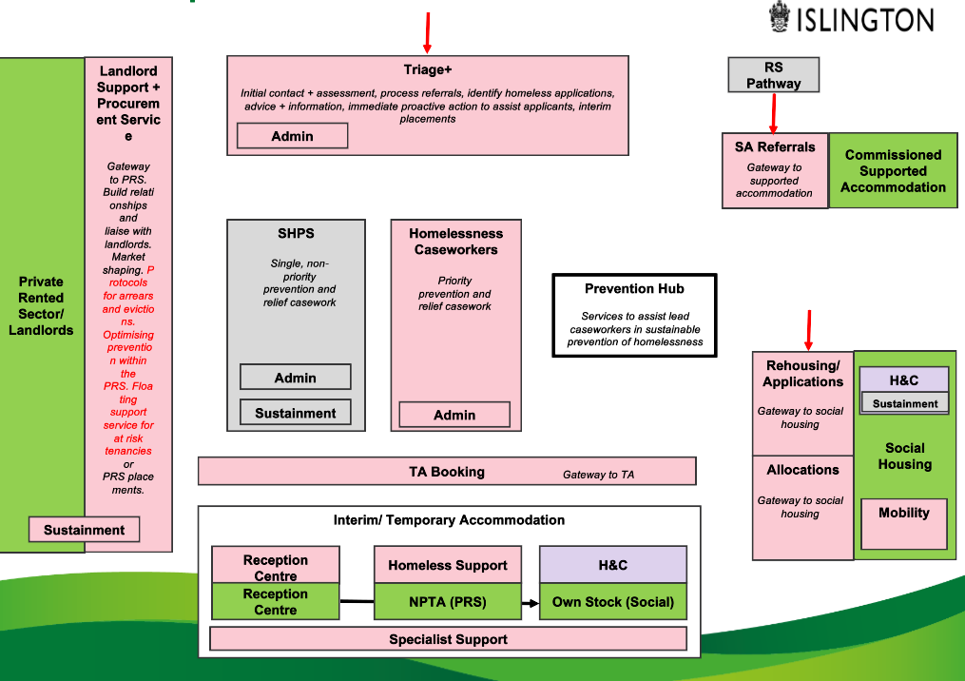
Core Service Option 1: Narrative
More proactive triage team with more skilled/ experienced staff and administrative support
Lead caseworkers throughout customer journey providing SPOC, with administrative support
Multi-agency portfolio of teams and services, data-led and over time responsive to trends in needs and demand
Move-on work as soon as households go into TA (at relief stage)
Coordinated gateway to options in the PRS, more procurement capability
Greater emphasis and monitoring of sustainability of PRS placements
Dedicated team for arrears recovery, closer QA of portfolio, greater emphasis on TA move-on

Slide 9
Core Service Option 1: Customer Journeys
Pre-56 days/ Approach
Initial Contact/ Assessment
+ Application
Triage+
Prevention Hub
(Casework Support)
TA Booking (Accomm. Gateway)
Inquiries + Assessment
+ PHP
SHPS
(Lead Caseworker)
Homelessness Caseworkers
(Lead Caseworker)
Prevention Duty
Landlord Support + Procurement
SA Referrals
Rehousing/ Applications
Allocations
(Accommodation Gateways)
TA Booking (Accomm. Gateway)
Relief Duty
HST/ RC/ H&C/ Specialist Support
(TA Caseworker – Relief Stage)
(Lead Caseworker – Main Duty)
Main Housing Duty
Sustainment/
Post-Service
SHPS
(Lead Caseworker)
Tenancy Sustainment (PRS/Social)

Slide 10
Core Service Option 1
Key Assumptions
There will be tenancy sustainment capability/ capacity for all PRS placements made by the Council
Every client will have a lead caseworker from SHPS or HC team during Prev/ Relief and from one of TA teams during main duty. Admin support and “lead” role in some cases, with suitable allocation and oversight, will keep caseloads manageable
Higher graded and more skilled triage team will have the required training and capacity to manage some of the demand into the service
“Help first/ investigate second” approach will lead to some people receiving help they are not legally entitled to
Triage+ officers will liaise with TA booking to set up interim TA placements before cases picked up by lead caseworker. Will require mix of customer facing/ non-customer facing to provide time to do this, with appropriate checks and balances
Procurement team will provide the main gateway and central route to access PRS properties. They will also manage strategic engagement with landlords. Early intervention work in the PRS will be picked up by other teams
Key Risks
Potential overlap for clients in interim accommodation during Relief stage – will have lead caseworker and TA caseworker. Roles will need to be clear
Continuity of support and emphasis on move-on when clients enter main duty stage
No specialist team/support for the “investigative” elements of the role. May impact support element or force officers to prioritise one or the other if spread too thin and/ or cause a backlog in decisions
Lack of accountability on others with lead workers, need to manage what happens when they are not there
A more proactive front door leads to gatekeeping

Slide 11
Core Service Option 2
EHPS
Private Rented Sector/ Landlords
Landlord Support + Procurement Service
Triage+
Initial contact + assessment, process referrals, identify homeless applications, advice + information, interim placements
Admin
SA Referrals
Commissioned Supported Accommodation
Gateway to PRS. Build relationships and liaise with landlords. Market shaping. Sustainment of PRS placements.
Gateway to supported accommodation
SHPS
Homelessness Caseworkers
Single, non-priority prevention and relief casework
Priority prevention and relief casework
Prevention Hub
Admin
Services to assist lead caseworkers in sustainable prevention of homelessness
Admin
Sustainment
Rehousing/ Applications
Social Housing
H&C
Inquiries + Decisions
Gateway to social housing
Sustainment
Main duty inquiries, decisions and discharge
TA Booking
Allocations
Gateway to TA
Gateway to social housing
Mobility
Sustainment
Interim/ Temporary Accommodation
Reception Centre
Homeless Support
H&C
Reception Centre
NPTA (PRS)
Own Stock (Social)
Specialist Support
Arrears Recovery

Slide 12
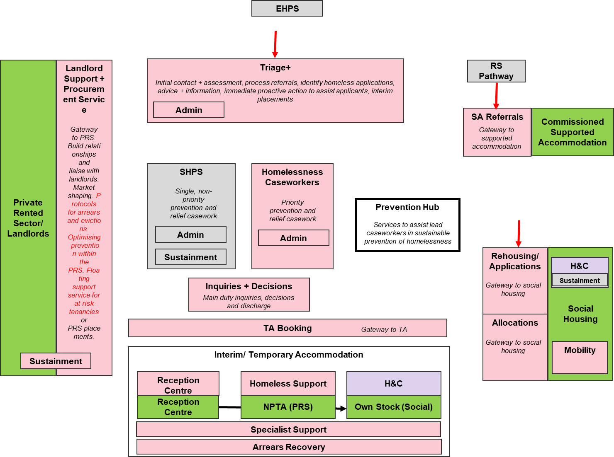
Core Service Option 2: Narrative
Dedicated team for “investigative” vs. support elements of the caseworker role at end of relief/ Main Duty stage

Slide 13
Core Service Option 2: Customer Journeys
Pre-56 days/ Approach
Initial Contact/ Assessment
+ Application
Triage+
Prevention Hub
(Casework Support)
TA Booking (Accomm. Gateway)
Inquiries + Assessment
+ PHP
SHPS
(Lead Caseworker)
Homelessness Caseworkers
(Lead Caseworker)
Prevention Duty
Landlord Support + Procurement
SA Referrals
Rehousing/ Applications
Allocations
(Accommodation Gateways)
TA Booking (Accomm. Gateway)
Relief Duty
HST/ RC/ H&C/ Specialist Support
(TA Caseworker – Relief Stage)
(Lead Caseworker – Main Duty)
Inquiries + Decisions
Main Housing Duty
Sustainment/
Post-Service
SHPS
(Lead Caseworker)
Tenancy Sustainment (PRS/Social)

Slide 14
Core Service Option 2
Key Assumptions
Inquiries + Decisions team will not be lead caseworkers. They will support relevant inquiries and decisions to notify and discharge the main housing duty – “the investigative element” particularly around priority need, intentionality, local connection etc.
Caseloads will be manageable
The additional workload for this team (i.e. inquiries and decisions to be made) and the subsequent work it removes from the lead caseworkers to support clients (and develop empathic relationships) results in added value to the service and quicker decisions for customers
Key Risks
Additional team that will have contact with the client and make the process more complicated. Roles and accountabilities will need to be clear
Continues to place high emphasis on decision making/ investigation?
Less flexibility with more specialism – e.g. sickness and leave within the I&D team
Potentially less value if it is later in the process and haven’t had the time to familiarise and understand client’s situation
If the homelessness caseworkers/ SHPS are picking up the H/TWH and eligibility decisions for prevention/ relief duties, is there a need for the team

Slide 15
Core Service Options: Prevention Hub
Triage+
Current State
Informal Negotiation & Mediation
Example Future State
New/ Change
Prevention Hub
HC/ SHPS
Client
Prevention Fund
Rough Sleeping/ SA Pathway (complex needs/ MD)
Informal Negotiation & Mediation
Complex Needs Floating Support
YPs (16-25) Floating Support
Independent Futures, Leaving Care Service
Support Need
Domestic Abuse
Landlord Support + Procurement
Employment
Debt + Welfare
Intervention
PRS Access
DHP/ Crisis Support
Tenancy Sustainment/ Floating Support
Negotiation/ Mediation – F+F
Negotiation/ Mediation – Landlord
Internal council team
Specialist roles or teams (Housing Needs)
Offending History
Mental Health
Commissioned
Single (under 35)
Drug + Alcohol
Range of support services for lead caseworkers and Triage+ to draw on. Mixture of in-house specialist roles/ teams and other agencies/ internal teams. Resourced appropriately to cover nature of demands on the service (cohorts, reasons for approach etc.) and support needs of households.

Slide 16
Core Service Options: Prevention Hub
Key Assumptions
SHPS/HC caseworkers will have base training in mediation & negotiation, with access to prevention funds and other forms of financial support
Landlord Support + Procurement service will be the main gateway to find, access and match PRS properties
Employment, crisis support and domestic abuse services used are currently fit for purpose in supporting the Housing Needs service
Referrals need to be quick and easy
Should be focused on things that can’t be provided by homelessness caseworker role to sufficient skill/ capacity
Key Risks
Maintaining flexibility of the services and how they are delivered (in-house, partner, commissioned etc.) to respond appropriately to changing needs and demands of service users
Unnecessary duplication

Slide 17
Core Service Options: Closer integration with Children's
Current State
Option: Housing Navigators
Option: Integrated Front Door (or other services)
Option: Multi-Agency Hub
Early Help
Housing + Children's Services Contact Team
e.g. for young people (examples in Bristol, Greenwich, Birmingham etc.). See also dedicated pathways and models of partnership working
Triage
CSCT (inc. MASH)
Housing Navigator(s)
Targeted Youth Support/ YOS
Single point of contact for all services for children, young people, and families who may need extra help and support; inc. those in housing need
Joint assessment protocol (16/17 year olds)
Housing Navigator
Housing Needs
Children’s Services
MASH
Housing Navigator
Independent Futures (Leaving Care Service)
YPs (16-25) Floating Support (SHP)
Supported Accommodation
Housing Navigator
Provides housing options and support services for 16-17 year olds, young people aged 18- 24 years and care leavers aged 18-24 who are at risk of homelessness, as part of an integrated youth service. Fully integrated one stop service led by Children’s Services, in partnership with housing, health, and third sector providers
Housing navigators located in key teams within Children's services. Role will vary depending on team but generally represent service by providing in-depth specialist housing help, navigating options, help accessing accommodation, upskilling CSC colleagues etc.
Two departments work together to provide assessment, homelessness prevention and access to suitable accommodation. Children's services would need to take the lead on some elements and vice versa for others

Slide 18
Core Service Options: Closer integration with Children's
Key Assumptions
Home visiting, combined with the use of informal negotiation and mediation skills is highly effective when used consistently
Mediation should be accessible, prior to crisis to help reduce tensions within the family.
Local authorities should consistently offer services such as family mediation and/or counselling with options for these to be held in formal or informal settings.
Key Risks

Slide 19
Core Service Options: Dedicated pathways (DA/ YP/ CN)
St. Basils Positive Pathway
Current State
Option: Same route with 'generic' support
Option: Same route with 'specialist' support for client group
Option: Unique and dedicated route
DA
YP
CN
CN
DA
YP
CN
DA
YP
CN
Triage+
1. Universal Prev.
2. Early Help
Triage+
DA Hub
YP Hub
CN Hub
1. Universal Prev.
2. Early Help
SHPS
Homelessness Caseworkers
Specialist officers/ services e.g. family mediators, colocation with VAWG charity
UP
UP
UP
3. Crisis Prevention + Relief
SHPS
Homelessness Caseworkers
EH
EH
EH
Prevention Hub
3. Crisis Prevention + Relief
CP+R
CP+R
CP+R
Prevention Hub
Specialist officers/ services for client group inc. Integration with other teams (e.g. young people, family mediators etc.)
Supported Housing Referrals
Supported Housing Referrals
Supported Housing Referrals
4. Commissioned Accommodation + Support
4. Commissioned Accommodation + Support
4. Commissioned Accommodation + Support
Generic officers are trained in specific needs of key cohorts (e.g. DASH risk assessment) and customer journey is the same
Broad customer journey is the same but specialisms located throughout journey to provide additional support to key cohorts
e.g. NRPF service. Fully integrated one stop service with multiple agencies co-located
Source: https://stbasils.org.uk/news/refreshed-positive-pathway-documents-launched/

Slide 20
Core Service Options: Dedicated pathways (DA/ YP/ CN)
Key Assumptions
Most DA approaches comes through council tenancies and Housing Tenancy Services – dealt with outside of homelessness completely
Refuges/ PRS via Solace referrals. Commissioned by VAWG service in Children’s
Key Risks

Slide 21
Core Service Options: Partnership working
Current State
Option: Colocation
Option: MA Hubs/ Integrated Service
Option: Partner "Open-Access" + MA Casework
Partner Locations
E.g. Youth Hub or Employment + Housing Support Service
Lead Homelessness Caseworker
Housing Navigators
Household PHP
Triage+
Homelessness Caseworkers
Partners
Other Council Teams
Prevention Hub
External Partners
Specialist
Partner
Partner
Partners
Either within partner locations or in the service. Will need to be agreed on a case by case basis. Those proposed so far include JCP, probation, hospitals, children’s & adult’s services
Specific teams or hubs with officers from the service and partners e.g. Pathway’s model for hospital discharge
Opening up the service and customer journey to partners – main methods are via the PHP and case management system. Increased emphasis on multi-agency casework vs. just Housing Needs officers

Slide 22
Core Service Options: Partnership working
Key Assumptions
The restructure and other accompanying service changes will continue to offer more opportunities for joint working with partners and see partners taking on more responsibility, regardless of the models or methods used
Lead caseworkers will remain the SPOC from the Housing Needs service while a statutory duty is owed. Appropriate continuity of support where relevant will be agreed/ communicated to clients on discharge
Data sharing issues can be resolved pragmatically
Key partners are supportive of this
Key Risks
Will need to develop a more collaborative culture/ ethos within the service
Council retains the legal duties so will need appropriate oversight/ quality assurance mechanisms agreed with partners

Slide 23
Additional option: Early intervention + outreach
Current State
Option: Dedicated EI + Outreach Team (Pre-56 Days)
Option: EI + Outreach in Community
Option: Combination of both
EI + Outreach
Community Locations
Dedicated team which includes officers based in community locations
Universal Options + Advice
Partner Engagement/ Upskilling
Housing Specialists
Identify At Risk Households (Data)
Early Integrated Casework
Floating Advice Surgeries
Community Navigators
Tenancy Relations Officers
Pre-Eviction + Arrears Protocols
Option: Capabilities within Triage+ team
Floating Support
Early Mediation
Locate some of these capabilities within the Triage+ function?
Early help services
Housing navigator(s)
Range of capabilities that could be included in a dedicated team – would include a mixture of proactive "case finding" and picking up cases that don't meet the crisis 56-day threshold. Should include close working with existing Early help services and key partners e.g. landlords
Expanding the housing options service from one virtual/ physical location. Building community resilience and picking up cases early to avoid escalation to the 56-day threshold

Slide 24
Additional option: Early intervention + outreach
Key Assumptions
If they meet the threshold for statutory duty, client will have a lead worker from main service. Any pre-existing work started by EI+O team (e.g. mediation, floating support) could continue if appropriate; coordinated by lead worker during prevention/ relief duty stage
The “case finding” work of the team will invariably identify more households needing support, but the value of earlier intervention and avoiding escalation will benefit the service over time
The data capability within the team will enable proper evaluation, demonstrate the case for earlier intervention and evidence the number of homeless applications avoided/ demand reduced for the rest of the service
Key Risks
Additional handover point for clients working with EI + Outreach team who then meet statutory threshold
Duplication between specialisms within the EI+O team and the Prevention Hub/ Triage+/ Lead Caseworkers. Will need to make sure it is clear who each is working with and when

Slide 25
Additional options
Significantly enhanced digital provision inc. at 'front door' to the service
Peer mentors to support clients through the service
Dedicated commissioning/ contract management capability for the service
Accommodation finding service – one brokerage team to various accommodation gateways/ options

